Slide 1
BRAC: AN INTRODUCTION
PROFESSOR SYED M HASHEMI

Slide 2
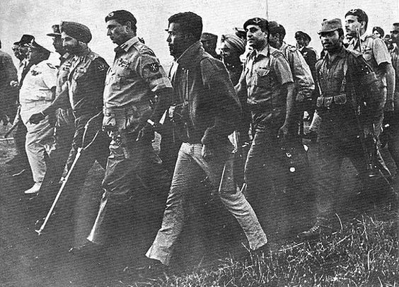
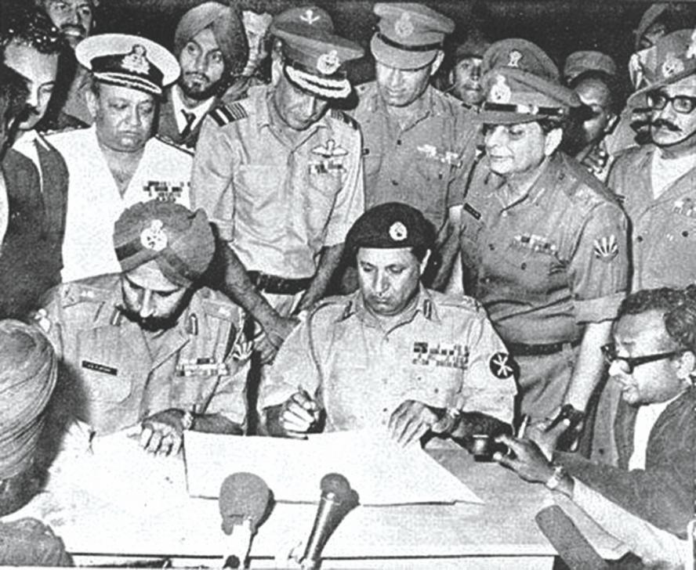
THE LIBERATION OF BANGLADESH: DECEMBER 16, 1971

Slide 3
BANGLADESH AT INDEPENDENCE
Bangladesh, devastated during 1971 genocide and war of liberation, was described as a “basket case” by Henry Kissinger
GDP of the first two years were negative.
    -6.83% in 1971
    -14.74% in 1972
Poverty rate was 70%
Economy was dependent on rain-fed agriculture
Only 61% (by 1981 census) found work at market wages
Per capita income in 1972 (US$) - 129

Slide 4
BANGLADESH AT INDEPENDENCE
Other indicators:
Population Growth Rate -2.6%
Life Expectancy – 46.5 Years
Infant mortality rate beyond the age of 5 – 239 out of 1000
Literacy Rate – 24.3% (Female Literacy- 14.8%)
    Primary Enrollment rate – 60% (Girl enrollment- 41%)
    Secondary Enrollment – 18.1% (Girl enrollment- 7.9%)
Rural and urban were isolated worlds, where urban areas consisted of 7.7% of the population
Population living in rural areas- 92.099%

Slide 5
TREMENDOUS NATIONAL ENERGY IN REBUILDING BANGLADESH
Fazle Hasan Abed returns to Bangladesh January 1972
creates BRAC: January 1972
conduct relief and rehabilitation in Sulla
starts long term Sulla (community) development: October 1972
build community centers (gonokendros)
provide adult literacy & occupational skills development programs
form cooperative societies
Abed had previous experience in disaster relief creating HELP and providing relief in 1970 cyclone devastated Manpura

Slide 6
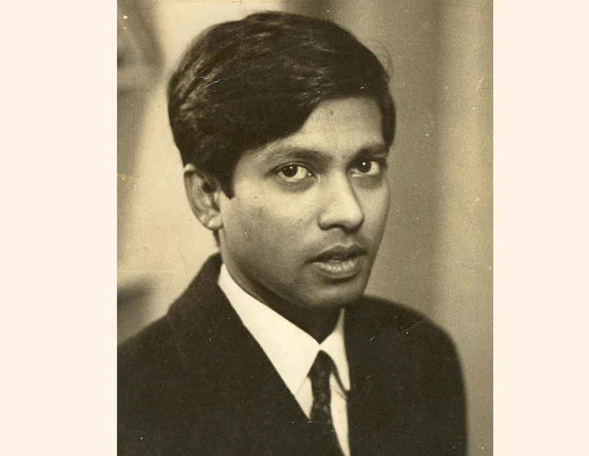
FOUNDER OF BRAC
SIR FAZLE HASAN ABED KCMG

Slide 7
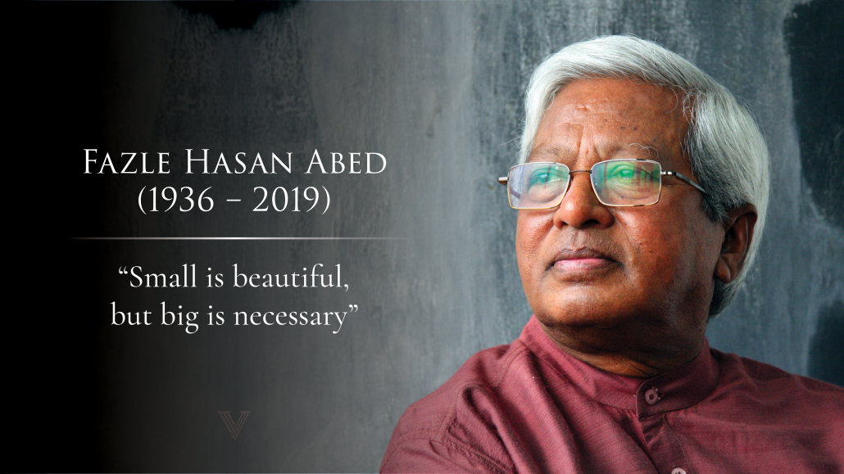
FOUNDER OF BRAC
Please add picture of Sir Fazle Hasan Abed

Slide 8
LESSON FROM SULLA
Need for self-reflection and transparency
Build staff competency
management
adult education
health paramedics
Focus on savings
Develop income generating activities
Target women
Move from handouts to cost-recovery
Reduce donor dependence through internal resource mobilization
long term sustainability critical for development

Slide 9
BRAC EXPANSION TO JAMALPUR AND MANIKGANJ
Jamalpur: June 1975
exclusively for a small number of FFW recipient women
literacy training
health hygiene and family planning
joint savings
cooperative economic activities in poultry and horticulture
self confidence and self esteem
staffing from local 8th grade educated women
Manikganj: end 1975
functional education centers
health workers and paramedics
cooperatives with savings and loan services
Source: Ian Smillie

Slide 10
BRAC’S UNDERSTANDING OF POWER STRUCTURES
BRAC’s immersion in post-independence rural Bangladesh and first hand understanding of poverty and the poor led to major critical insights
Poverty was not a mere economic phenomenon, nor was it a “natural” condition; poverty was created, strengthened and reproduced through unequal structures of power
unequal landownership and resources
dominant kinship and factions
linkages to political and bureaucratic elites
control of capital markets (moneylending, usury, dadan)
control of product markets (payment of low prices to producers)
control of labor markets (low wages, advance sale of labor,
extra economic coercion
patriarchal structures
BRAC recognized that creating economic opportunities need to go hand in hand with poor people organizing to confront such inequities

Slide 11
RURAL CREDIT AND TRAINING PROGRAM
RCTP: A Phased Development-Credit Program
baseline surveys of villages to assess economic contexts
selection of clients and projects for credit
members from poor economic groups organize into “samities”
members train in functional education (conscientization)
members engage in savings programs
members start group economic activities
1986: RCTP phased into the Rural Development Program

Slide 12
INTERVENING IN THE MARKET
BRAC Value Chains
SERICULTURE
POULTRY
DAIRY

Slide 13
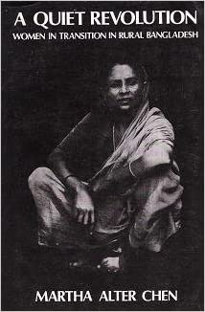
CRITICAL INSIGHT INTO EARLY BRAC
Documents BRAC’s early efforts to understand patriarchy and the conditions of poor, rural women and determine strategies to increase their material and social resources.

Slide 14
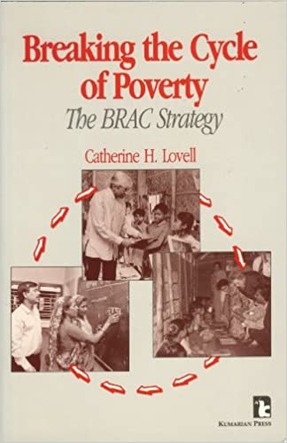
CRITICAL INSIGHT INTO EARLY BRAC
Describes and analyzes BRAC’s early history, strategies, programs, management systems, and resource base.

Slide 15

FREEDOM FROM WANT: THE REMARKABLE SUCCESS
STORY OF BRAC
Presents a clear, insightful understanding of the historical evolution of BRAC, from its early days at Sulla to the world’s largest learning institution dedicated to ending poverty and improving the conditions of the poor and the powerless.

Slide 16
SOCIAL DEVELOPMENT
Eliminating extreme poverty
Expanding financial choices
Employable skills for decent work
Climate change and emergencies
Gender equality
Universal access to healthcare
Pro-poor urban development
Investing in the next generation

Slide 17
SOCIAL ENTERPRISES
Aarong
BRAC Dairy
BRAC Seed and Agro
BRAC Artificial Insemination
BRAC Nursery
BRAC Sericulture
BRAC Fisheries
BRAC Recycled Handmade Paper
BRAC Cold Storage
BRAC Salt
BRAC Printing Pack
BRAC Sanitary Napkin and Delivery Kit

Slide 18
INVESTMENTS: INVESTING FOR SOCIAL IMPACT
BRAC Bank
BRACNet
IPDC Finance Limited
Delta BRAC Housing (DBH) Finance Corporation Limited
Guardian Life Insurance
BRAC IT Services
BRAC Tea Estates

Slide 19
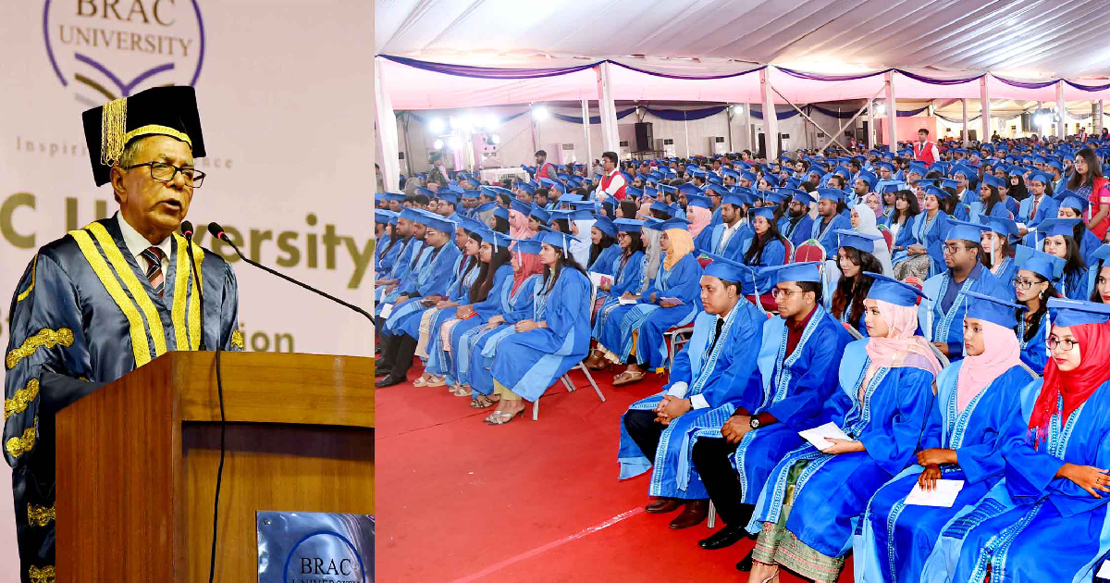
BRAC UNIVERSITY

Slide 20
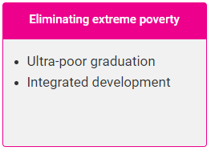
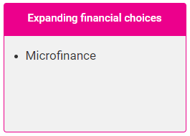
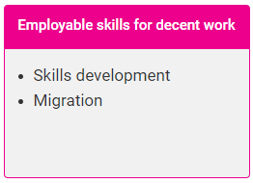
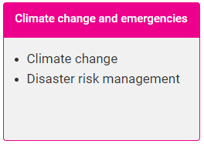
SOCIAL DEVELOPMENT

Slide 21
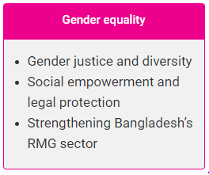

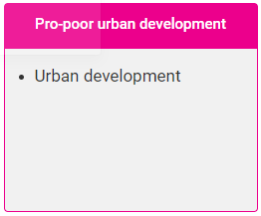
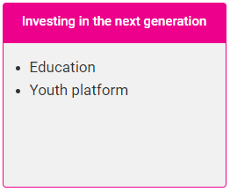
SOCIAL DEVELOPMENT

Slide 22
BRAC Timeline
1972 | The Creation of BRAC Relief and reconstruction in a new country
1973 | Rebuilding Lives Long term rural community development
1974 | First in Microfinance Providing access to finance to the poor
1975 | First NGO in Bangladesh to start a research and evaluation division
1977 | Village Organizations Organizing the poor based on solidarity and mutual support
1977 | Retail Enterprises Aarong set up to market handicrafts of poor rural artisans
1977 | Shasthyo Shebika Voluntary health workers
1979 | Oral Rehydration Therapy Program Teaching Bangladesh to prepare ORS
1980s | Income Generating Enterprises cold storage, printing press, iodized salt factory, tissue culture laboratory, bull station to improve cattle breeds
1983 | Poultry and Livestock Activities Developing model for the poor to be involved in the poultry and livestock sector

Slide 23
BRAC Timeline
1983 | Poultry and Livestock Activities Developing model for the poor to be involved in the poultry and livestock sector
1985 | Non Formal Primary Education BRAC schools for the poorest children
1986 | Speaking out on Human Rights Empowerment through legal education
1991 | Mother and Child Extending reproductive health care to pregnant women
1994 | Tackling Tuberculosis 83 million people covered in program with government
1995 | Shushasthyas – Health Centers Comprehensive health provision for the poor
1998 | Resolving Conflict- Legal Services Legal Aid clinics for people in communities
1998 | Fair Price for Milk Dairy plant for milk processing and marketing
1998 | Adibashis Expanding inclusive development programs to the Hill Tracts
2001 | BRAC Bank Support to small and medium enterprises

Slide 24
BRAC Timeline
2001 | BRAC University
2002 | Targeting to the Ultra Poor Graduating the poorest out of ultra-poverty
2002 | BRAC in Afghanistan Rebuilding after the devastation
2003 | Empowering Adolescent Girls program for training, social development and access to finance
2005 | Meeting the MDGs Working on health and hygiene
2006 | Global Expansion to Africa Program in Tanzania, Uganda, Southern Sudan, Sierra Leone and Liberia

